Slide 1

Introduction to GitHub
Version control for data professionals
Making your work reproducible, collaborative, and recoverable
I-AIR SEO: May 2026
Presenters:
James Anderson – Kaskaskia College
Joel Swenddal – University of Illinois Urbana-Champaign – jswen@illinois.edu

Slide 2
TODAY
Exploring uses for Git/GitHub
Teams using Git/GitHub for developing data products - Joel
Using GitHub to share common code (accessing, contributing, licenses) - James

Slide 3

THE PROBLEM
Does this look familiar?
analysis_FINAL.sql
Which one is right?
What changed?
Can I go back to
an older version?
analysis_FINAL_v2.sql
analysis_FINAL_v2_USE_THIS.sql
analysis_FINAL_v2_USE_THIS_fixed.sql
analysis_FINAL_v2_USE_THIS_fixed_JAN.sql
analysis_FINAL_v2_USE_THIS_fixed_JAN_FINAL.sql
Sound familiar? Git solves exactly this.

Slide 4
COMMON USE CASES
Data professionals can use software development practices.
Dashboard Development
Pipelines
Developing dashboards IS software development even when it is low-code (Tableau/Power BI).
All parts of a process can be grouped together in one repository (SQL, Python, SSIS, SAS, etc).

Slide 5




WHAT IS IT?
Version control is a time machine
for your work.
Full History
Time Travel
Every change ever made is saved with who made it and why.
Revert any file — or the whole project — to any past state.
Compare
Safety Net
See exactly what changed between any two versions, line by line.
Experiment freely. Nothing is ever truly lost.

Slide 6

KEY CONCEPTS
Git and GitHub: What's the difference?
GIT
GITHUB
The tool
The platform
Software on your computer
Website that hosts your repos
Tracks changes locally
Syncs your work to the cloud
Works completely offline
Collaboration & code review
Command-line interface (CLI)
Web interface (no CLI needed)
The engine under the hood
The garage where Git lives
Think of Git as the engine and GitHub as the car dealership — one powers, the other makes it accessible.

Slide 7



WHY US?
Why should data professionals care?
Audit trail for your queries
Know exactly which version of a SQL script or Python job produced last quarter's report — even 2 years later.
Safe experimentation
Tweak your ETL logic on a branch. If it breaks, your working version is untouched.
Team collaboration
Multiple analysts working on the same codebase without overwriting each other's work.
Supports reproducibility
Stakeholders ask 'how did you get this number?' You can answer, with proof.

Slide 8





USE CASE
Collaborating on a Dashboard Project
Multiple analysts, one shared codebase — no overwriting, no confusion.
1
The 'Main' branch lives in a shared GitHub repository — it's the production version of the dashboard.
5
They open a Pull Request on GitHub — proposing their changes for review.
2
A contributor clones the repository to their local machine.
6
Team members review the changes and approve or request edits.
3
They create a development branch and make their changes safely, without touching Main.
7
Once approved, the changes merge into Main. Everyone pulling Main now gets the updated dashboard.
4
When done, they push their branch up to GitHub.

Slide 9
HOW IT WORKS
The basic Git/GitHub workflow
1
2
3
4
5
Make
Changes
Stage
Commit
Push
Pull Request
▶
▶
▶
▶
Edit your files
normally
Tell Git which
changes to save
Snapshot saved
to local history
Send to GitHub
(the cloud)
Team reviews
before merging
Local machine ←————————————————————————→ GitHub (remote)
Steps 1–3 happen locally
Steps 4–5 go to GitHub

Slide 10
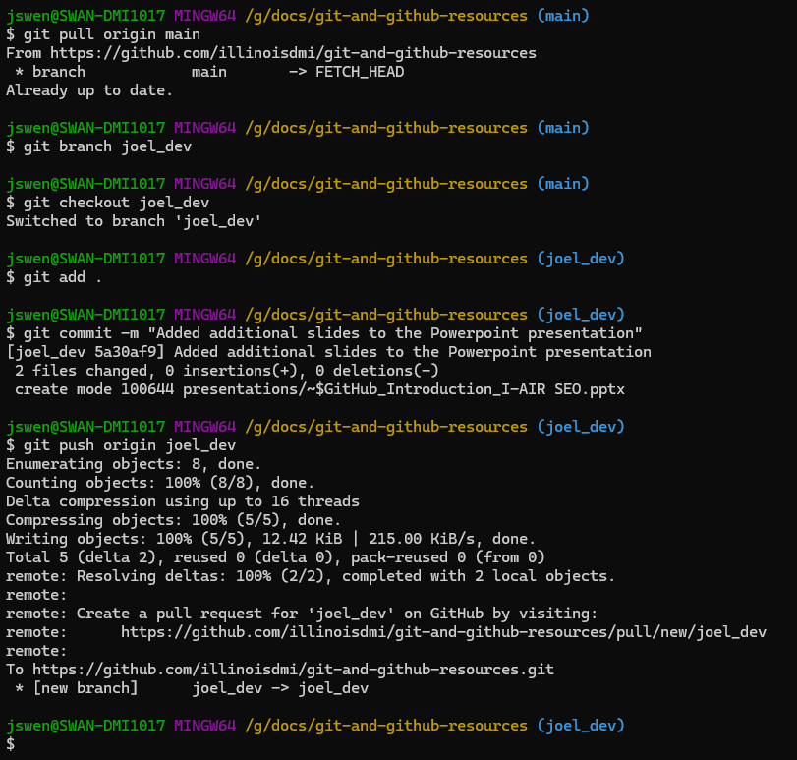
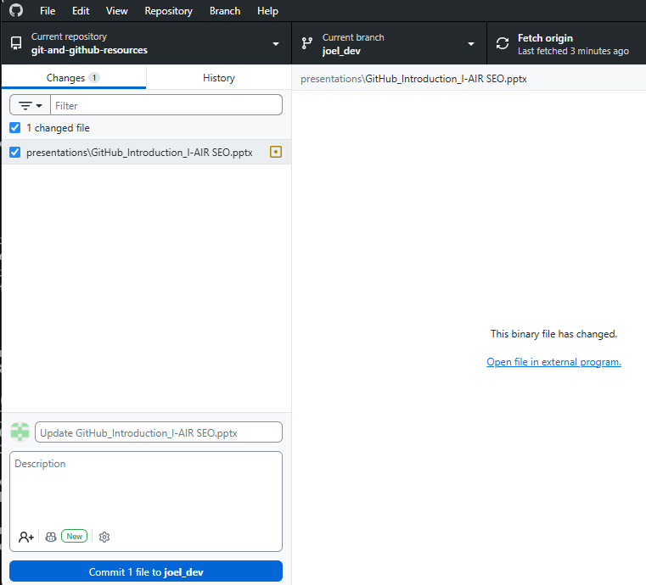
GIT TOOLS
CLI or GUI tools are available
PowerShell, Bash
GitHub Desktop

Slide 11
Ready to go further?
Free resources to get started today
W3Schools Git Tutorial
GitHub Skills (interactive)
w3schools.com/git
skills.github.com
Atlassian Git Tutorials
GitHub Cheat Sheet (PDF)
atlassian.com/git/tutorials
education.github.com/git-cheat-sheet-education.pdf
The best way to learn Git is to use it — even on a solo project.

